Slide 1
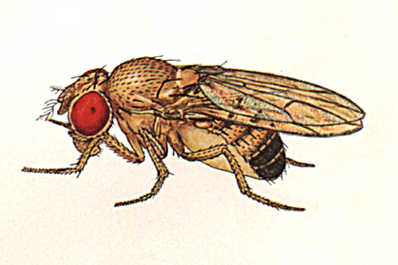
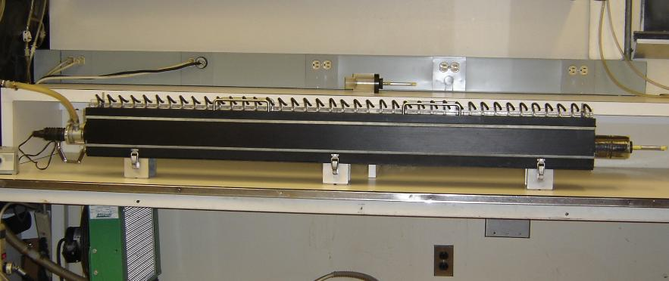
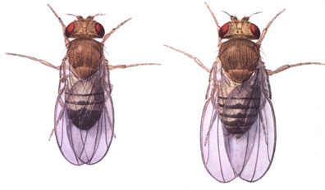
How does flying performance depend on sex and body size, in highly selected wind tunnel flies?
Shelley Collins, Katherine Villagran, Rosa Pauwels, Carina Brown, and Ken Weber; University of Southern Maine
Background: Flies have been selected for high performance in a wind tunnel—flying toward a light, against the wind—for 510 generations. The selected lines have evolved strong increases in attraction to light and flying speed. They score about 100 times as high as the ancestral (control) populations. We are now assessing the underlying and correlated genetic effects which have been caused by this large response to selection.
The Wind Tunnel (150cm long)
Conclusions: As expected, bigger flies are faster in both sexes. But the dependence of speed on size is different in males and females. Males are much faster flyers than females of the same size. Females are slower for their size—probably because they carry large ovaries full of developing eggs. This makes them less efficient fliers. Male flies have no such “excess baggage” to slow them down. Yet females are the overall “winners” in every sample of flies—i.e., they have the fastest average speed and the fastest individuals. But this is simply because they are so much bigger than males.
The Problem: The average speed of flies in selected lines is consistently higher for females than for males. Females are also larger than males on average. In general, larger flies can fly faster than smaller flies. Accurate measurements are now required to find out how performance depends on body size in males and females. Do females fly faster than males only because they are larger, or is one sex actually faster for its size?
The Experiment: We routinely measure flying speeds every generation on a sample of a few hundred flies. These are separated into 40 compartments in the wind tunnel according to their performance. The result is a distribution like the one at right. For this experiment, we transferred the flies from each numbered compartment into a numbered holding vial. We then separated the flies from each compartment into males and females under a stereomicroscope, recorded the numbers of males and females for each compartment. We then took out the fastest and slowest 20 individuals of each sex . Each group of 20 flies was weighed by placing them in a previously tared cryogenic vial to prevent moisture loss. We also separately calculated the mean flying speed for each group of 20 fast or slow males or females.
Male
Female
Weber, K. (2002) Population size and long-term selection. In Long-term Selection, Jules Janick, ed. Plant Breeding Reviews 24 (Part 1): 249-268
Marden, J. H., Wolf, M. R. and Weber, K. E. (1997) Aerial performance of Drosophila melanogaster from populations selected for upwind flight ability. J. Exp. Biol. 200: 2747-2755

